Slide 1
food delivery time prediction
DATA ANALYTICS AND PREDICTIVE MODELING
Group 8
Suyash Arlimar (50475246)
Siddharth Gavhane (50546237)
Dhiraj Landge (50479342)

Slide 2
CONTENTS:
1. Motivation
2. Introduction
3. Methodology
4. Data Collection and Processing
5. Data Visualization
6. Data Modelling
7. Conclusion

Slide 3

Motivation:
Analysis of food delivery time is an important practice.
Important to understand customer demands
Instrumental in improving efficiency, customer satisfaction and market advantage
This analysis could be as catalyst in continuous improvement in services
Weather Disruptions

Slide 4

Introduction:
Understanding factors influencing delivery time is crucial for a seamless customer experience.
Analysis includes elements such as delivery person's age, rating, festival season, traffic condition, and weather condition.
Examining these factors provides insights into the specific elements impacting food delivery time.
Identifying these factors is key for improvement in the overall delivery process.
Understanding and optimizing these factors contribute to creating a more satisfying and reliable service.
The goal is to foster long-term customer loyalty.

Slide 5
Methodology:
Data sources and collection methods
Selecting relevant predictors for model
Feature engineering
Regression models with selected predictors
Data cleaning and pre-processing
Calculating performance metrics (RMSE, R2)
Interpretation of results
Comparison of model performance

Slide 6
Data Collection and Processing:
Data was sourced from a public repository containing data about Zomato app.
We pre-processed the data by removing the missing values.
The missing values were replaced by mean of that particular value, and in some cases mode.
We made dummy variables for some predictors containing categorical values.
Converted latitude and longitude coordinates into distances in kilometres.
Condensed columns such as ‘time ordered’ and ‘time delivered’ into ‘time’ for simplicity.
Data was split into 70% training set and 30% validation set.

Slide 7
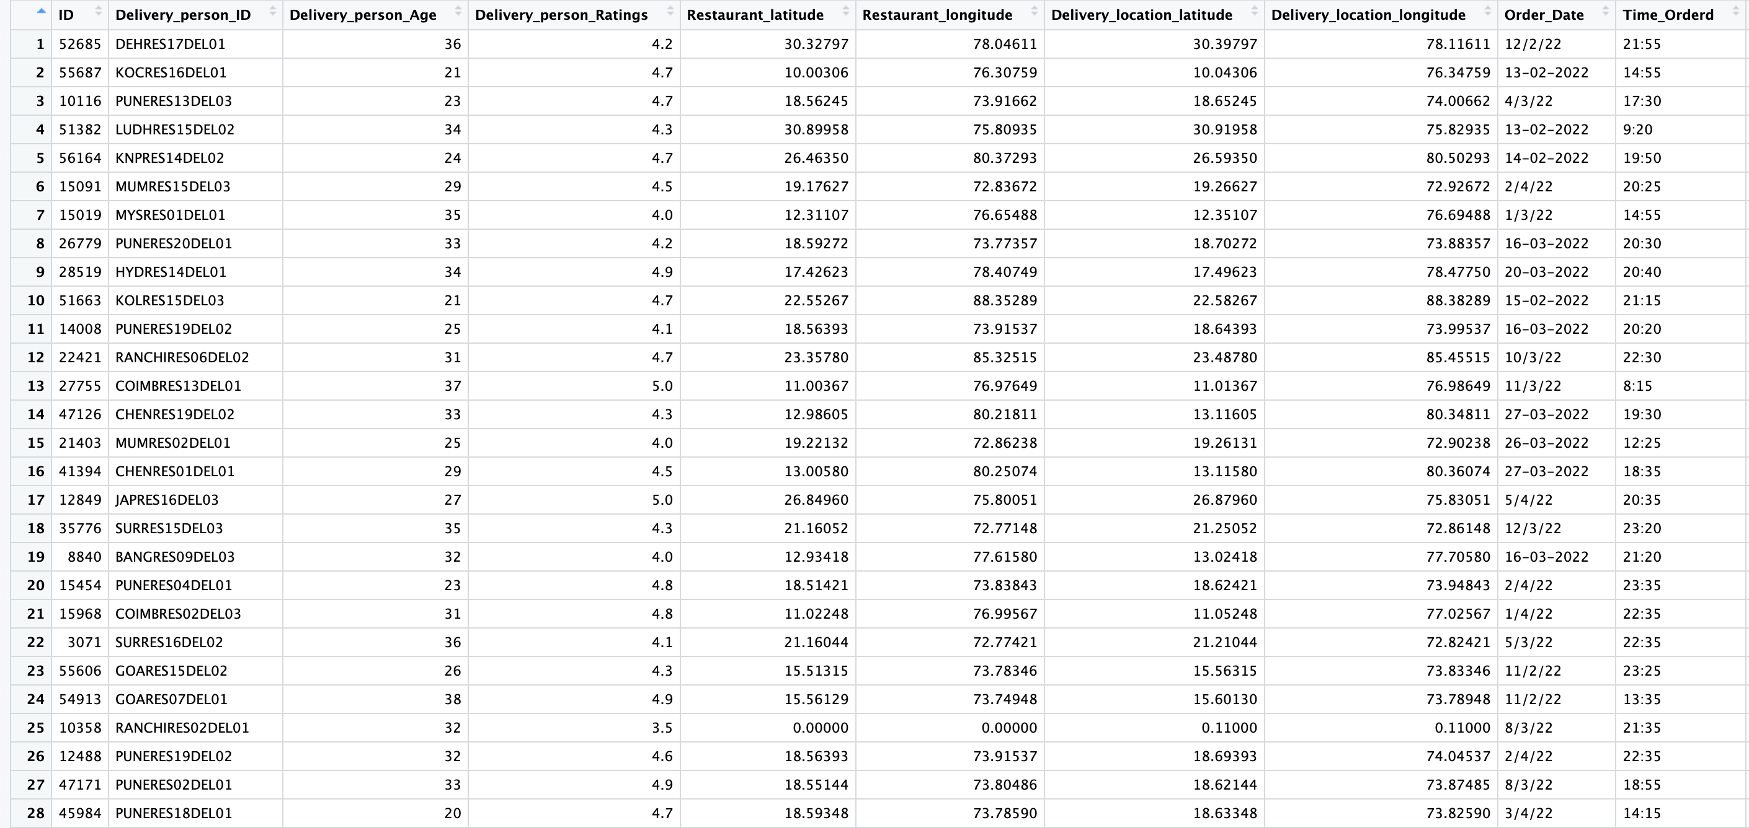
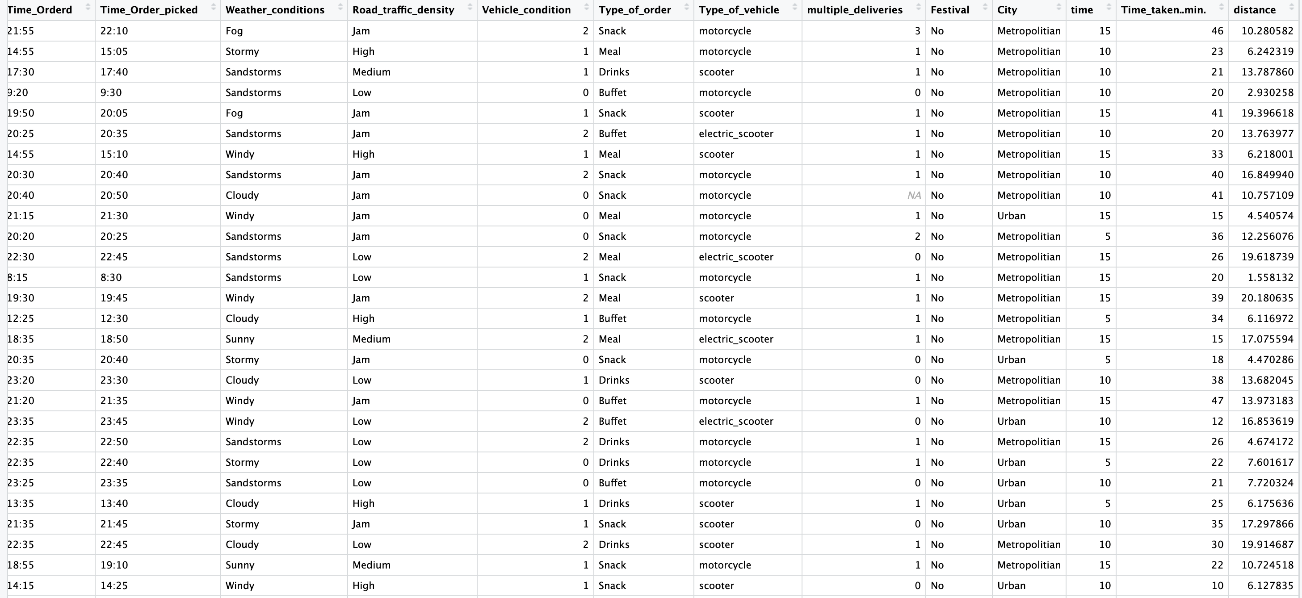
Dataset:

Slide 8
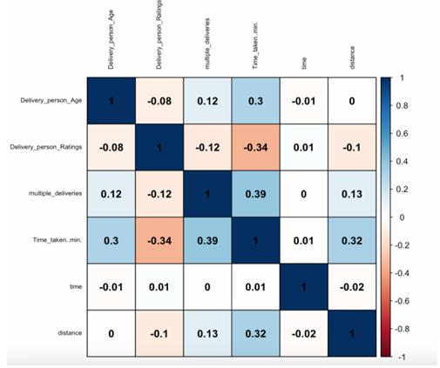
Exploratory Data Analysis: (corrplot)
From the corrplot, we can see that some predictors have a greater impact on the response variable, time taken
Predictors such as Multiple deliveries, delivery person age, distance have a high positive correlation with the response variable
Delivery person rating has a negative correlation with response variable.

Slide 9
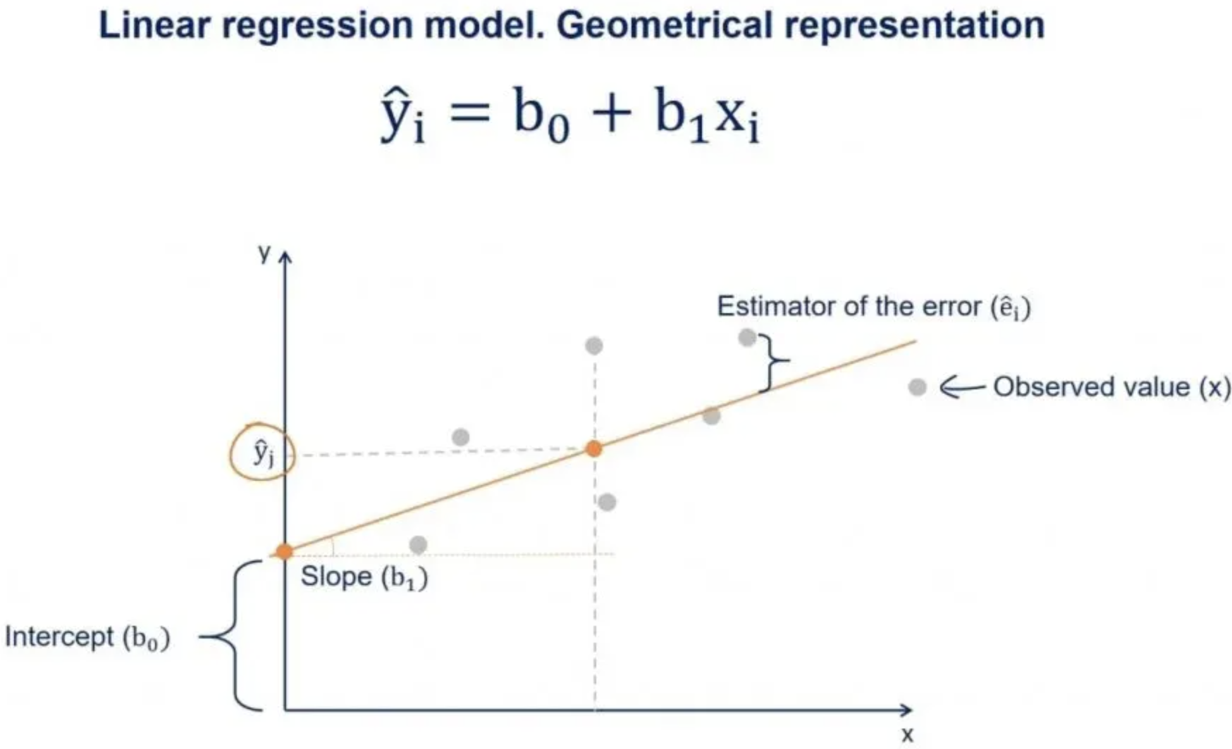
Models
Linear Regression
Ridge Regression
Lasso
Decision Tree
RandomForest
Gradient Boosting

Slide 10
Comparison
Linear Regression
5.9325
0.6017
Ridge Regression
1.0854
0.9867
Lasso
0.2740
0.9895
Decision Tree
5.8312
0.6152
RandomForest
3.7425
0.8415
Gradient Boosting
0.1146
0.9925

Slide 11

Conclusion:
We choose gradient boosting as our best model
It has lowest test RMSE out of all the models and very high test R2 score.
This will help with resource optimization and improve customer experience.
Accurate prediction can help in making business decisions which can improve efficiency of operation and increase revenue.

Slide 12

Thank You

